Slide 1
FAYETTE COUNTY, GEORGIA
FY2026 Budget Presentation
SECOND public hearing
June 26, 2025
Notes:
This is the second and final hearing for the FY2026 budget

Slide 2
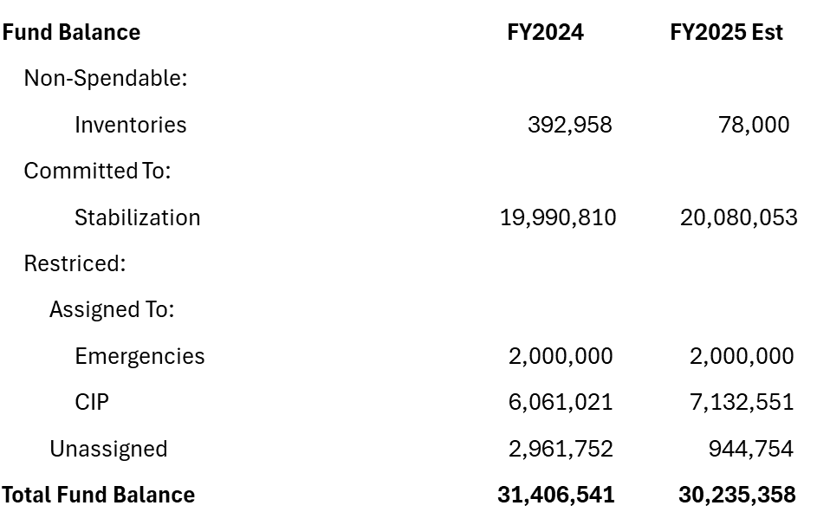
General Fund Balance
Financial Projection – FY2025
Notes:
Retreat forecast $30,235,358
The $7.13M is the newest proposed GF CIP for FY2026 through FY2030
And as always, 3 months of expenses (FY2026) set aside in the committed section – Stabilization $20.08M

Slide 3
FY2026 Budget Summary
Notes:
Budget Summary for the FY2026 budget has a positive net impact to the GF fund balance of $2,363,693
VER – fund balance $11.78M
Estimated unassigned FY2025 $945k

Slide 4
Fayette County, Georgia
FY2026 Proposed Budget Items Presented on May 22
Notes:
The following slides are amendments to the budget provided on May 22

Slide 5
Budget Discussion Item #6
Griffin Circuit Transition
 |  |  |  |  | Current Proposed Budget | Amended Proposed Budget | Difference
General Fund
Revenue
State Grant for Juvenile Judges salary |  |  |  |  | 0 | 125,000 | 125,000
Reimbursement from Griffin Judicial Circuit |  |  |  |  | 0 | 217,927 | 217,927
Total Revenue |  |  |  |  | 0 | 342,927 | 342,927
Expenditures
Circuit Contract - Superior/Juvenile Ct |  |  |  |  | 630,228 | 0 | (630,228)
Salary/Benefits |  |  |  |  | 0 | 955,737 | 955,737
Other Expenditures |  |  |  |  | 0 | 17,418 | 17,418
Total expenditures |  |  |  |  | 630,228 | 973,155 | 342,927
 | Effect on GF fund balance |  |  |  | (630,228) | (630,228) | 0
Notes:
Calculations are as follows:
County pays expenses of $955,737 + 17,418 = $973,155
= $973,155 – 125,000 = $848,155 Net Expense
= $848,155 – 630,226 = $217,927 owed to Fayette County
/ 12 = $18,160 per month to be paid to FC from GJC

Slide 6
Budget Discussion Item #6
Griffin Circuit Transition
        As of July 1, 2025, the accounting for the Griffin Judicial Circuit (GJC) will transition to an external audit firm
        Fayette County will still retain the management and tracking of the ARPA Judicial grant through the end of 2025
        This transition will require modifications in the financial system as to where the employees in the GJC will be paid from

Slide 7
Budget Discussion Item #6
Griffin Circuit Transition
        For FY2026 (and future), Fayette County’s share of the GJC budget is 43%, but pays 63% of GJC budget, primarily because 99% are payroll related for 10 GJC employees
        Fayette County has proposed GJC reimburse the county a monthly allocation to cover the variance between the actual costs and GJC share allocation ($18,160/Mo)
        Fayette County has agreed to retain the Juvenile Court and ARPA Judicial Grants management and tracking
Notes:
We will have these changes ready at the next hearing on June 26.
The County will transfer a portion of the fund balance next week and the remainder in early July.
GJC has requested that we retain the ARPA Judicial Grant management and tracking
And has asked that we retain 10 people on our payroll, these will be paid from General Fund, and any reimbursements will go back to the GF as well.

Slide 8
General Fund
Fund Balance Trends – Last 7 FY
Notes:
Stabilization Fund will vary each year based upon the next year’s anticipated M&O budget FY2025 $20,080,053
Emergency Fund has remained at a constant $2M
Non-spendable Other is an estimate based upon previous years’ inventories.
Unassigned estimated at $945kM
GF 5-year CIP is set aside at $7,132,551

Slide 9
General Fund
Original Adopted Budget
Notes:
Shows the continuing trend of the budget. Want the blue line to be higher than the red line… variance of $2,363,693

Slide 10
FY2026 Budget Highlights
  Significant operational budget considerations:
    Millage Rate remains at 3.763
    General Fund impact from maintenance & operations is positive
    Proposed Budget increases General Fund Balance $2,363,693
    Funds Rolling 5 Year Capital Improvement Program of $7,132,551
    Changes in Personnel levels protect the existing outstanding service delivery to our Citizens.
    Budget continues to maintain the commitment to balance current year revenues with current year expenses.
    Maintains Employee Benefits – Medical/Dental/Vision & Retirement
  County-Wide departmental cooperation continues to yield positive results.
Notes:
We have a balanced budget with a positive impact to GF of $2,363,693
The 5-year CIP is set aside in the GF $7,132,551
Maintaining service levels
Maintaining employee benefits

Slide 11
FY2026 Final Budget
      Adoption of the FY2026 Budget
      Approval of the 2025-06 Budget Resolution
Notes:
We request that the Board approve Resolution 2025-06 for the approval of the FY2026 budget

